Slide 1
LLM Development & Deployment
By Terry Tu

Slide 2
Main Problem we want to solve
Access to Medical Information:
Provide immediate and reliable answers to minor medical questions.
Reduce the burden on healthcare professionals by handling common inquiries.
User Convenience:
Offer a readily accessible platform through WeChat, a popular messaging app.
Enable users to get medical advice anytime and anywhere without the need for appointments.
Accurate and Contextual Responses:
Utilize advanced natural language processing (NLP) capabilities of the Llama model.
Ensure responses are contextually relevant and easy to understand for users.
Efficient Resource Utilization:
Optimize the use of GPU resources for handling computationally intensive tasks.
Maintain high performance and quick response times even with a high volume of queries.
Administrative Oversight:
Provide tools for administrators to monitor and manage the chatbot effectively.
Enable the continuous improvement of the chatbot based on user interactions and feedback.
Data Management:
Securely store user data and chat logs for future reference and analysis.
Ensure data integrity and accessibility for administrative purposes.

Slide 3
Main Function of the Chatbot
User Interaction via WeChat:
Seamlessly integrates with WeChat to interact with users.
Receives and processes user messages through the WeChat API.
Backend Processing:
Utilizes Django to manage backend processes and API endpoints.
Employs Django REST Framework (DRF) for creating RESTful APIs.
Integrates with the Llama model for natural language understanding and response generation.
Llama Model Deployment:
Uses a powerful Llama language model hosted on a server with dual NVIDIA RTX 3090 GPUs.
Processes user inputs to provide accurate and contextually relevant responses.
Administrative Interface:
Provides an admin dashboard for monitoring and managing chatbot interactions.
Allows administrators to view chat logs, user data, and system performance metrics.
Enables configuration and maintenance of chatbot settings.
Database Management:
Utilizes PostgreSQL for storing user profiles, chat logs, and other relevant data.
Ensures efficient data retrieval and storage for all chatbot interactions.
Scalability and Performance:
Designed to handle multiple concurrent users efficiently.
Leverages GPU resources for fast and accurate response generation.

Slide 4
Technology Stack Ideas - Frontend
JavaScript (with frameworks like React, Vue.js, or Angular)
Pros: Widely used, large community support, and extensive libraries.
Use Cases: Building web-based admin interfaces, dashboards, and monitoring tools.
HTML/CSS
Pros: Simple to use, essential for web development.
Use Cases: Basic web interfaces and static pages.

Slide 5
Technology Stack Ideas - Backend
Node.js (JavaScript)
Pros: Non-blocking I/O, good for handling multiple concurrent connections, large ecosystem.
Use Cases: Building scalable server-side applications, integrating with WeChat APIs.
Java
Pros: Strong performance, robustness, and extensive libraries for enterprise applications.
Use Cases: Backend services requiring high performance and scalability.

Slide 6
Technology Stack Ideas - Backend cont.
Using Django for Backend
Django can handle the backend tasks for your chatbot, such as managing API requests, interfacing with the Llama model, and integrating with WeChat's API. Here’s how Django fits into the overall architecture:
API Development: Use Django REST Framework (DRF) to create RESTful APIs that can handle requests from the WeChat platform.
Model Integration: Load and run the Llama model using Django views or separate worker processes for handling intensive computations.
WeChat Integration: Set up Django views to act as webhooks for receiving and responding to WeChat messages.
Admin Interface: Use Django's built-in admin panel to monitor and manage chatbot interactions, logs, and user data.

Slide 7
Technology Stack Ideas - Database
SQLite: Good for development and testing due to its simplicity, but not recommended for production use. (i.e. local deployment)
PostgreSQL: Highly recommended for production due to its robustness, scalability, and support for complex queries.
MySQL: Another good choice for production
MongoDB: Suitable for storing unstructured data like chat logs, though Django's primary ORM does not support it out of the box. You can use third-party packages like djongo to integrate MongoDB with Django.

Slide 8
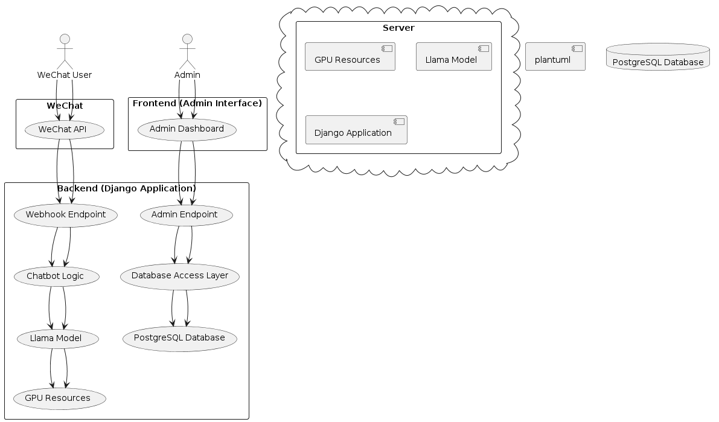
Project High Level Design
Notes:
Layer Explanations
WeChat API:
Purpose: Acts as the bridge between the WeChat user and your backend application.
Function: Receives messages from WeChat users and sends responses back to them.
Frontend (Admin Interface):
Admin Dashboard:
Purpose: Provides an interface for administrators to manage and monitor the chatbot.
Function: Allows admins to view chat logs, user data, and system status, and perform administrative tasks such as adjusting settings and viewing analytics.
Backend (Django Application):
Webhook Endpoint:
Purpose: Receives messages from the WeChat API.
Function: Processes incoming messages and routes them to the chatbot logic.
Chatbot Logic:
Purpose: Core logic for processing user inputs and generating responses.
Function: Takes user inputs, processes them using the Llama model, and generates appropriate responses.
Admin Endpoint:
Purpose: Handles requests from the admin dashboard.
Function: Provides data and functionalities to the admin interface, such as fetching user data, chat logs, and system metrics.
Database Access Layer:
Purpose: Interacts with the database.
Function: Provides an abstraction layer for reading from and writing to the PostgreSQL database, ensuring data is stored and retrieved efficiently.
PostgreSQL Database:
Purpose: Stores persistent data required by the chatbot and admin interface.
Function: Holds user profiles, chat logs, configurations, and other relevant data.
Server:
GPU Resources:
Purpose: Provides computational power needed for running the Llama model.
Function: Handles the intensive computations required by the Llama model for processing natural language inputs and generating outputs.
Llama Model:
Purpose: The machine learning model used to process and understand user inputs.
Function: Generates responses based on the input received from the chatbot logic.
Django Application:
Purpose: The main backend application running the chatbot logic and handling admin requests.
Function: Manages all backend functionalities, including interfacing with the Llama model, handling webhooks from WeChat, and serving the admin interface.

Slide 9
Summary of the Application
WeChat User: Interacts with the chatbot via the WeChat app.
WeChat API: Facilitates communication between the user and the backend.
Frontend (Admin Interface): Allows administrators to manage the chatbot system.
Backend (Django Application): Contains the core logic for processing user inputs and managing administrative tasks.
PostgreSQL Database: Stores all necessary data for the chatbot and admin functionalities.
Server: Hosts the Django application, Llama model, and GPU resources to ensure efficient processing and response generation.

Slide 10
Questions
What are the hardware resources we are granted? (i.e. 3090 GPU, cloud, database server)
What is the operating system of our server?
Are there any preferred tools, libraries, or frameworks we should use for development (e.g., Django, Flask, PyTorch)?
Are there any specific functionalities or features that the chatbot must include?
What are the expected use cases and user interactions for the chatbot?
Are there any specific requirements for the admin interface or monitoring tools?
Do we have a preferred database system for this project (e.g., PostgreSQL, MySQL)?
What are the expectations for monitoring the chatbot’s performance and usage?
What is the expected timeline for the project?

Slide 11
Thanks

